Slide 1
Liver Cirrhosis
Depi project

Slide 2
outline
Introduction
Dataset exploration
Data cleaning and preprocessing
EDA
Modeling

Slide 3
Introduction
Predicting the level of liver cirrhosis of a patient.
liver cirrhosis is critical sick because it can lead to death or in more lucky situations a liver transplant could make the patient survive.

Slide 4
Dataset exploration
N_Days: Number of days the patient has been in diagnosed
Status: Health status or outcome (target).
Drug: Medications or treatments the patient is receiving.
Age: Age of the patient in days.
Sex: Gender of the patient.
Ascites: Fluid buildup in the abdomen (Y, N).
Hepatomegaly: Enlargement of the liver (Y, N).
Spiders: Spider-like blood vessels on the skin (Y, N).
Edema: Swelling of the body (Y, N).
Bilirubin: Level of bilirubin in the blood, a key indicator of liver function.

Slide 5
Cont.
Cholesterol: Cholesterol levels.
Albumin: A protein produced by the liver, a marker for liver function.
Copper: Copper level in the blood, relevant for liver conditions.
Alk_Phos: Alkaline phosphatase, an enzyme related to liver function.
SGOT: Serum Glutamic-Oxaloacetic Transaminase, an enzyme that indicates liver health.
Triglycerides: Type of fat in the blood.
Platelets: Platelet count, related to blood clotting and liver function.
Prothrombin: A clotting factor, also linked to liver function.
Stage: Stage of liver cirrhosis (e.g., early stage, advanced).

Slide 6
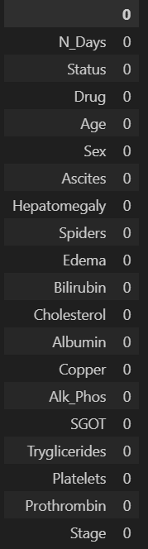
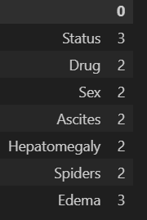
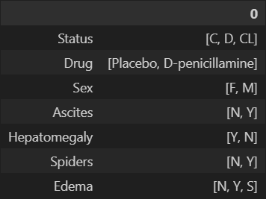
Data cleaning and preprcessing
Check missing values: there isn’t any
Check duplicates there is 15361 rows and drop them
How many unique values in categorical data. It tells how many dummy variable it needs to encode
Transforming age from days to years
What is the unique values of the categorical columns to know whether it has (?, none, etc) that cant be shown using isnull().sum()

Slide 7
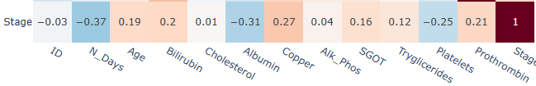
Weak correlation for all
Except for n_days, albumin, copper, paltelets it med
n_days are negative due to a longer u stay the more likely u will note survive

Slide 8
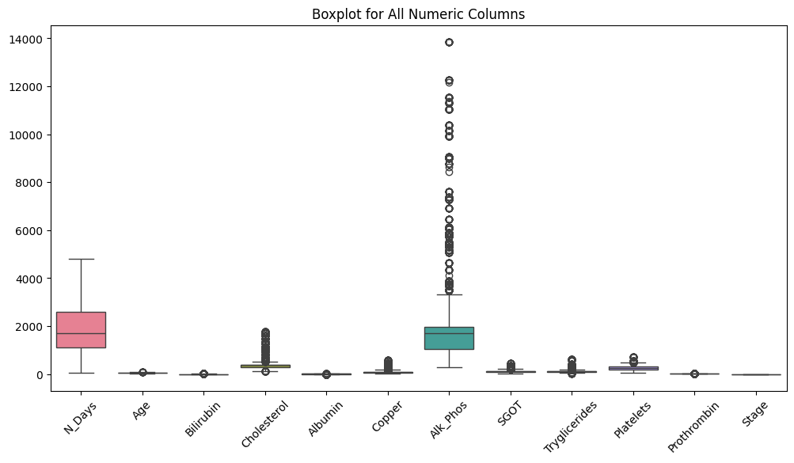
Eda
It shows outliers in ALK_Phos, Cholesterol, Triglycerides, Platelets, Sgot descending ordered.
The outliers handling it not easy because this is a real values not a bad entry or an usual values.

Slide 9
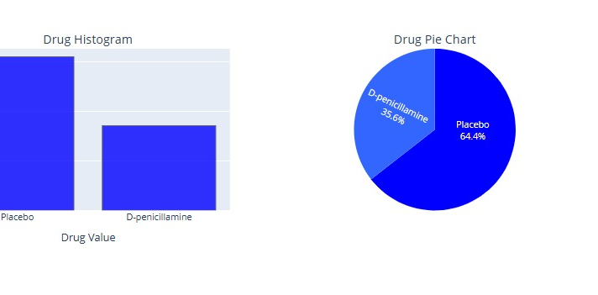
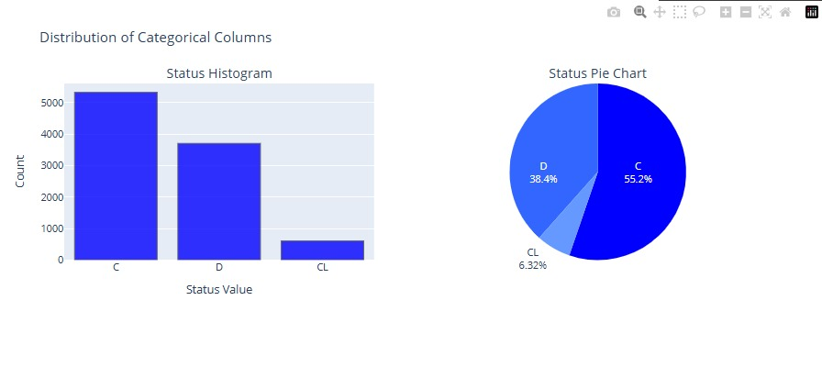
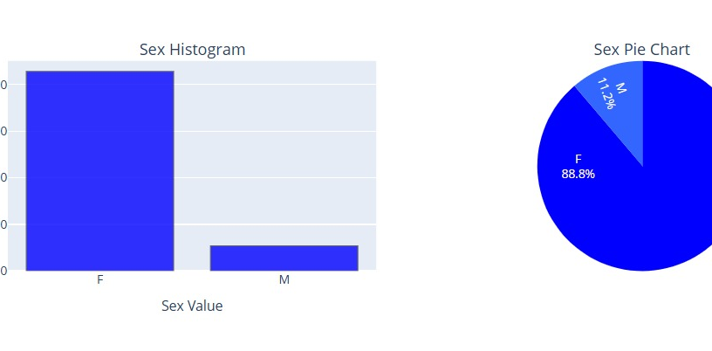
Distribution of the columns
There is a bias in the data that’s a problem need to be solved
Most of the dataset is females

Slide 10
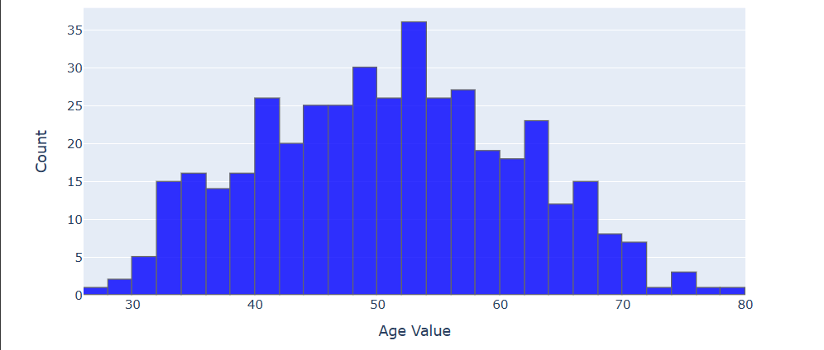
Distribution of the columns
The graph shows normal distribution of the ag
Liver cirrhosis most commonly affects people aged 45 to 65 years. The risk is highest in this age group due to longer exposure to liver-damaging conditions like alcohol use, chronic hepatitis, and non-alcoholic fatty liver disease. Reference: Schuppan, D., & Afdhal, N. H. (2008). Liver cirrhosis. The Lancet, 371(9615), 838-851.

Slide 11
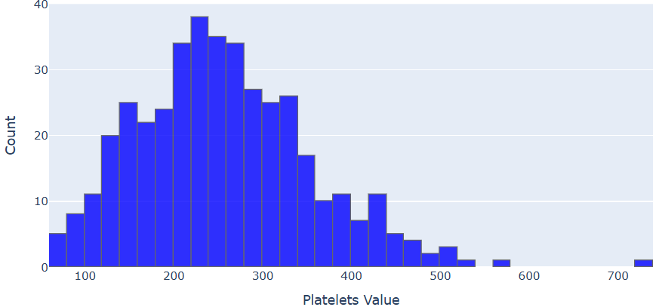
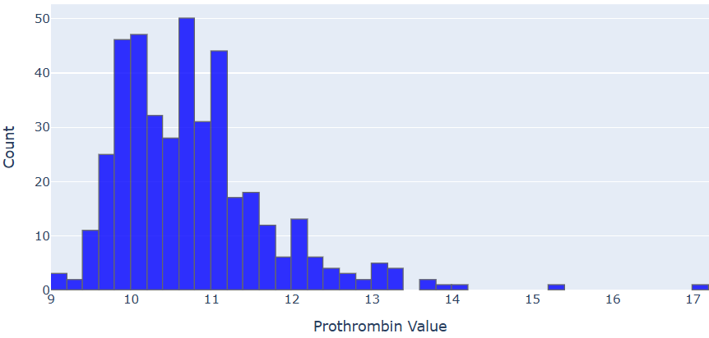
Distribution of the columns
Platelets: These are blood cells essential for clotting. In liver cirrhosis, platelet count often decreases (thrombocytopenia) due to spleen enlargement and reduced production, making bleeding more likely, the normal range from 150 to 310 mlg
Prothrombin: This is a clotting protein made by the liver. In cirrhosis, prothrombin levels drop, and the prothrombin time (PT) becomes prolonged, indicating impaired liver function and a higher bleeding risk. Normal range from 11 to 13.5 second
Reference: Garcia-Tsao, G., et al. (2017). Portal hypertension and variceal bleeding in cirrhosis: AASLD practice guidance. Hepatology, 65(1), 310–335.

Slide 12
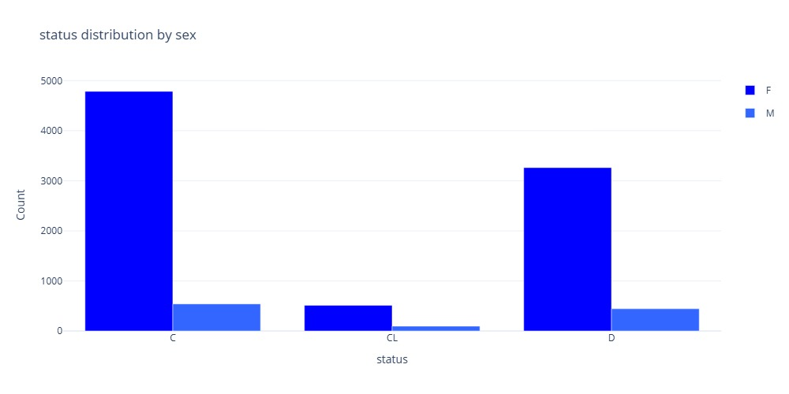
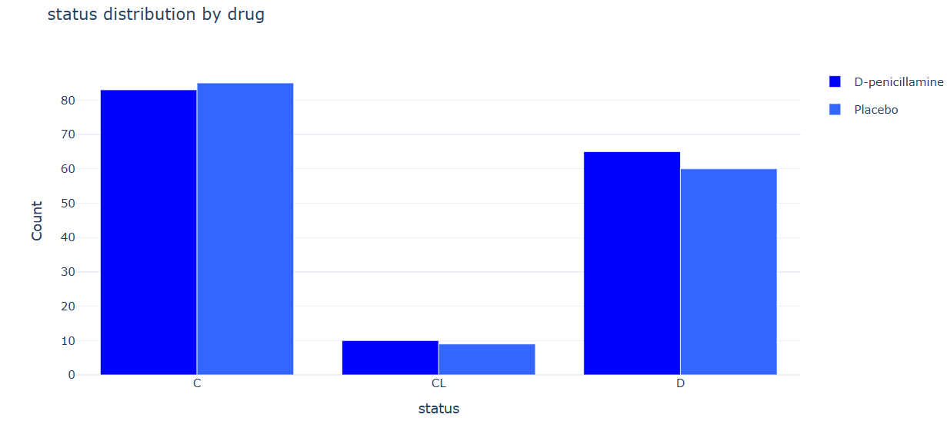
Distribution of the columns
Most of the dataset is females that’s a normal conclusion.
The drugs distribution shows that close values between each drug and the stage that means the drug has no effect of having cirrhosis or not.

Slide 13
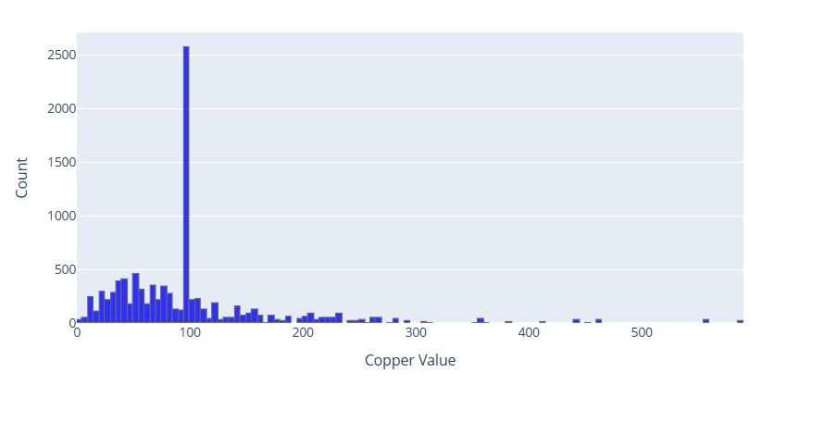
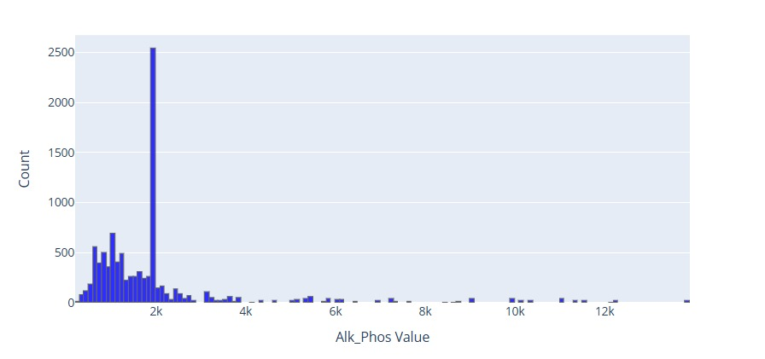
Distribution of the columns
the outliers is visualized more here
There is a lot of rows have 100 value copper column
And I alk_phose also 2k has a lot of rows
That could make the model biased to these values

Slide 14
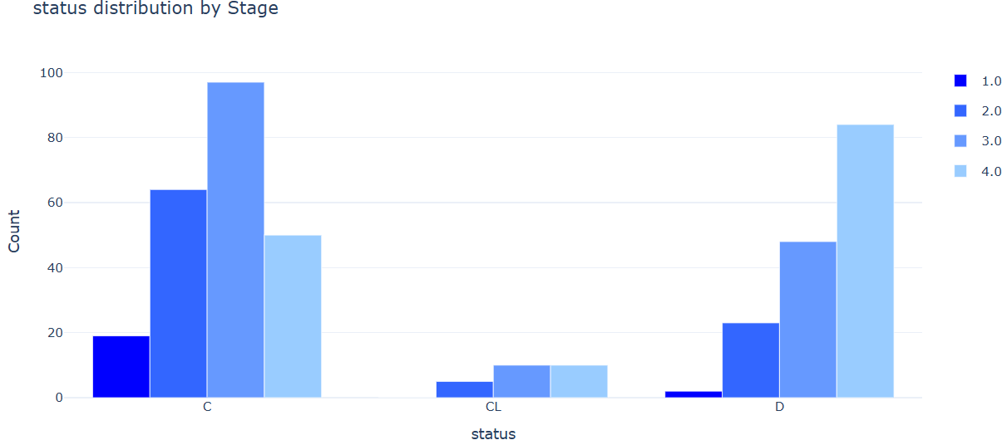
Distribution of the columns
The class cl has lower distribution that could make the model ignored it or predicted wrong
But most of the patient in class C are in stage 3 then 2 then 4
On other hand in class D most of the patient in stage 4 then 3 then 2, but 1 has lower values that means most of patients at stage 1 this condition not critical to death
However class cl the most is 3 then 4 then 2
We can say the patient in class c has higher probability of survive

Slide 15
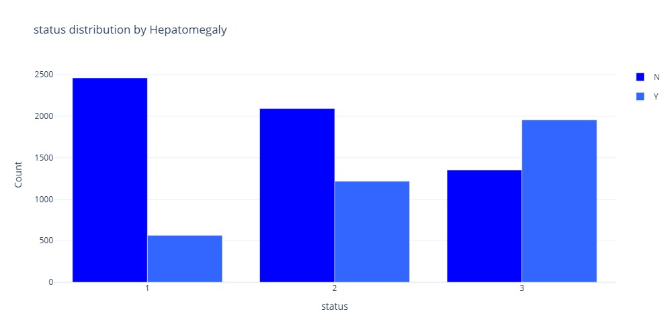
survival probability
We can say if the patient
At statues 1 most likely he doesn't have hepatomegaly.
At status 2 he might doesn’t have it
At statues 3 more likely he/she has it
The odds he doesn’t have could means he has better chances of survive

Slide 16
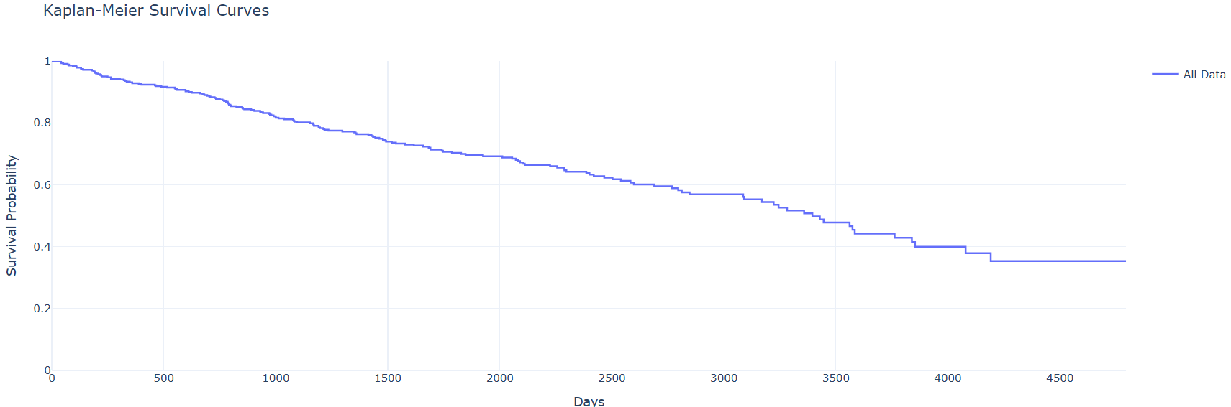
survival probability
The longer the patient stays in the hospital the more likely will not survive

Slide 17
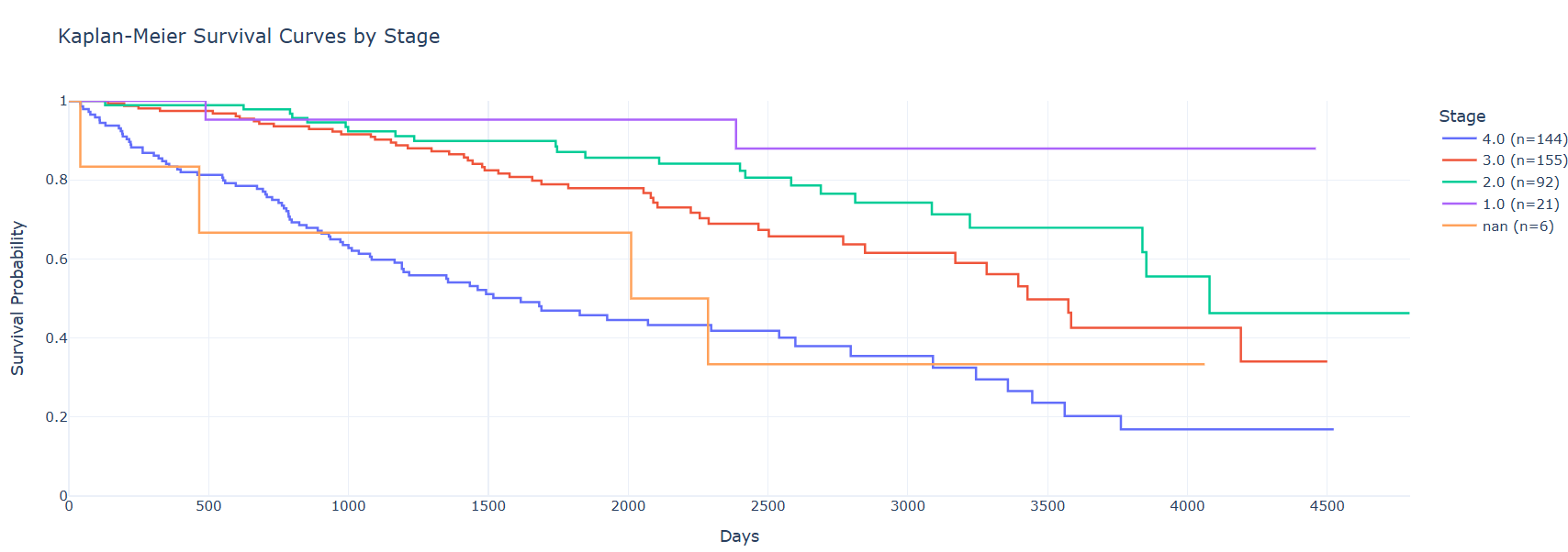
Death probability
Level 1 has higher chances of survival
Level 2 and 3 the chances gets better when he/she get diagnosed early, level 2 has no critical issues until 2500 day then his chances gets lower, but level 3 not that lucky he has until 2000 days this the condition drops quickly.
Level 4 his condition gets critical early and his survival chances not that high

Slide 18
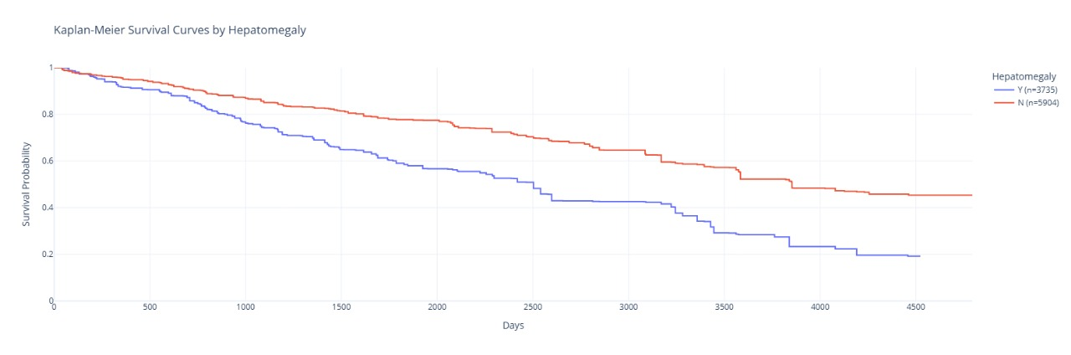
survival probability
In the graph shown that doesn’t have hepatomegaly makes the patient have higher chances

Slide 19
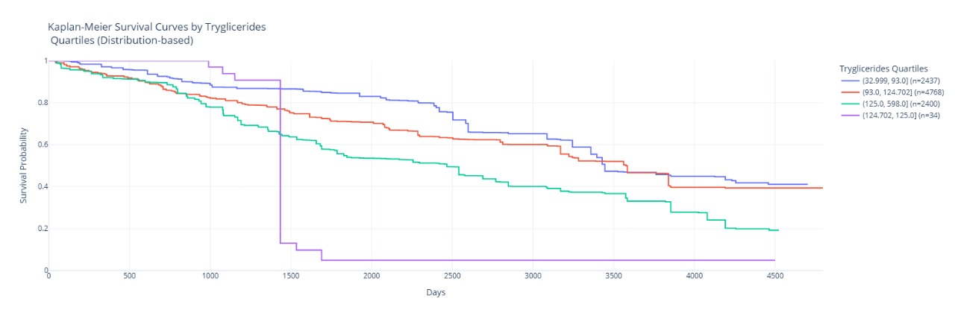
The look more scary for having abnormal amount of this type of fat in the blood. the first 1400 days u will be normal and better than normal with less death probability but at one moment you are dead (Rip)

Slide 20
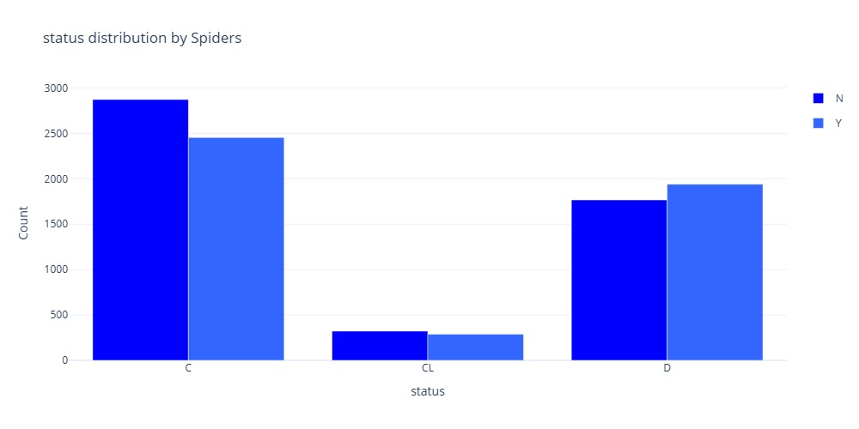
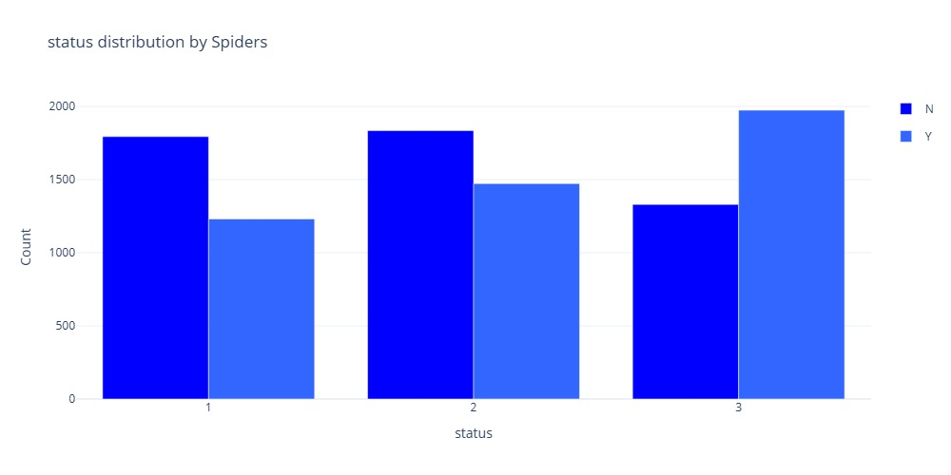
Distribution of the columns
The diagnoses of status 3 is spider veins
If the patient stated to notice a vaues that’s mean he is stage 2
Stage 1 doesn’t appear most likely

Slide 21
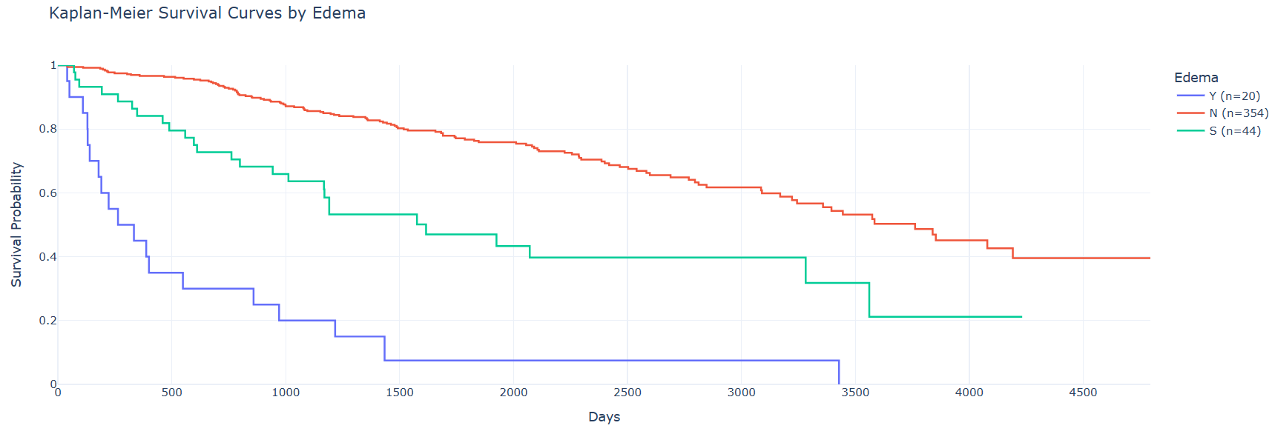
survival probability
Edema is related to kidneys retain salt and water.
Low albumin production by the liver → less fluid is held in blood vessels.

Slide 22
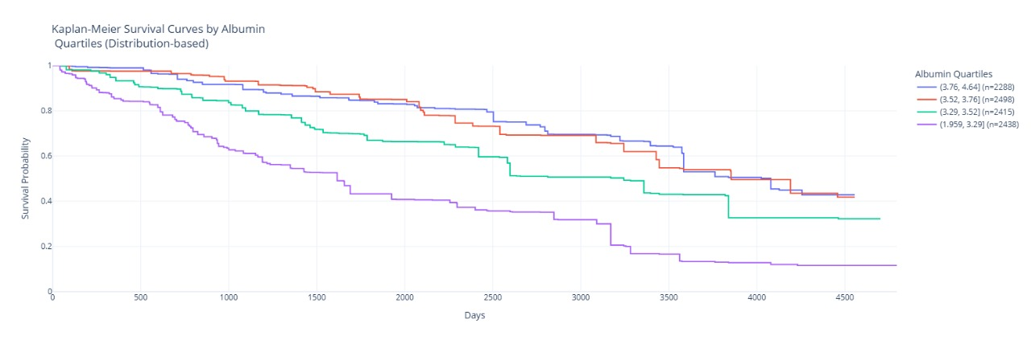
Having a lot of this protein it could lead to death

Slide 23
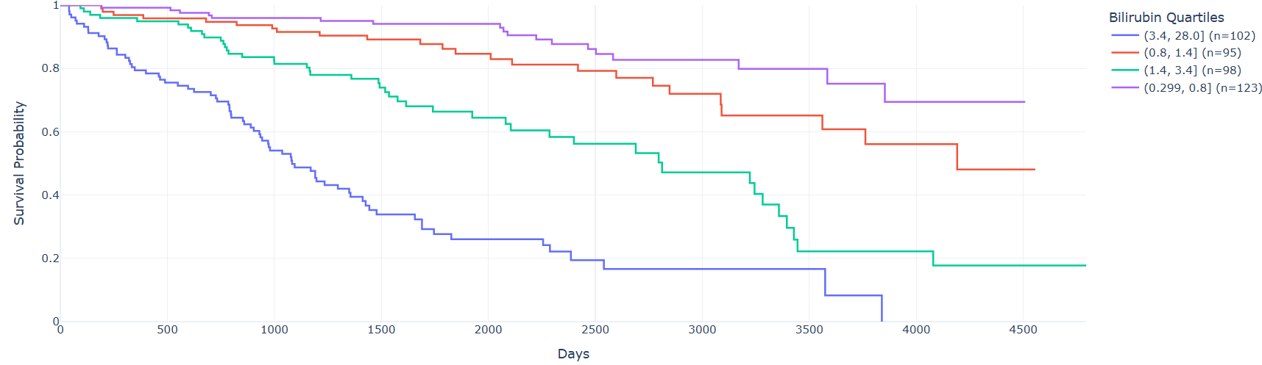
survival probability
Bilirubin is crucial due to it measures the functionality of the liver.
Have lower or abnormal level is a clear indicator of death.
Even with a slightly up normal levels that make the survival chances drops

Slide 24
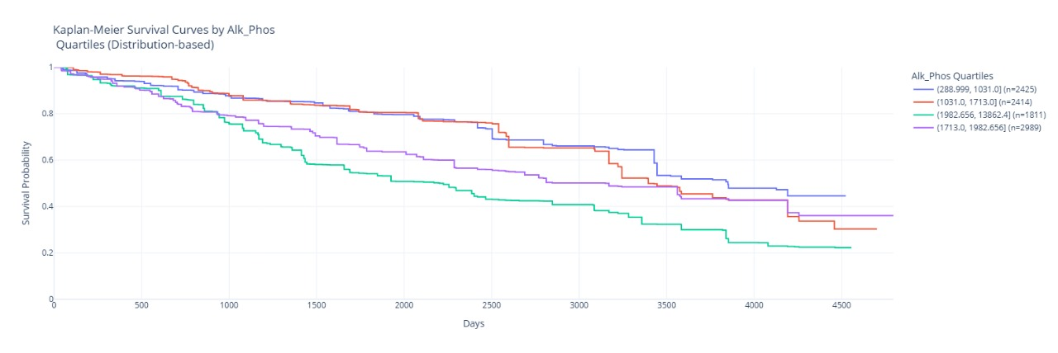
Its look like a normal chars have Alkaline phosphatase, (an enzyme related to liver function) having a lot of it could cause death like any other enzymes in your body

Slide 25
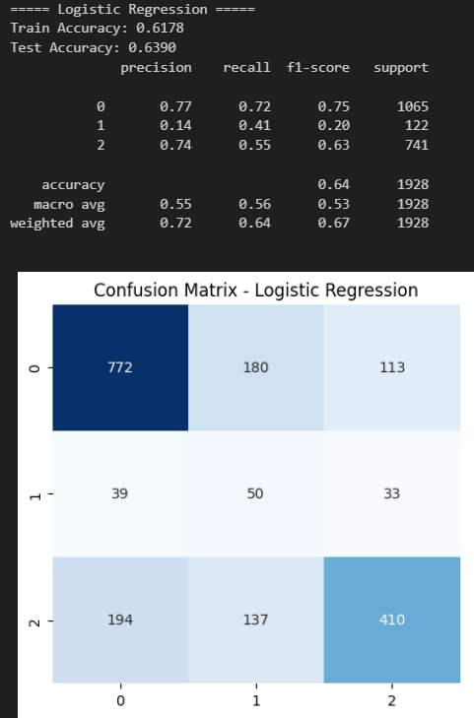
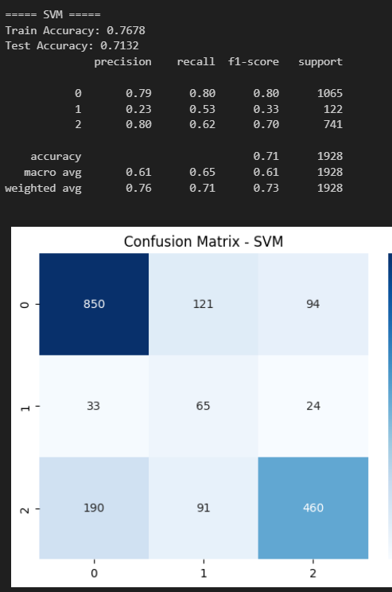
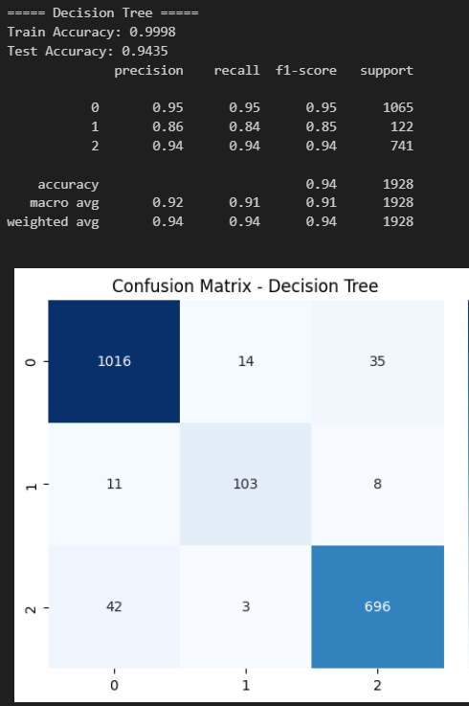
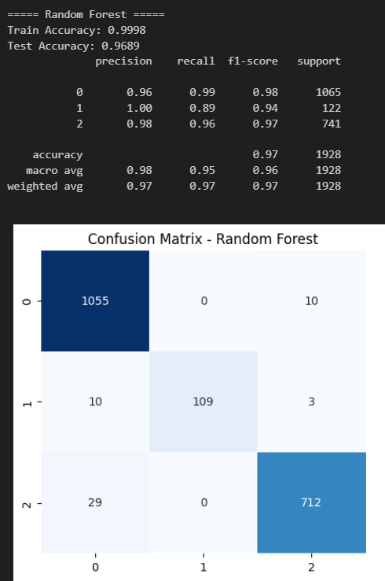
Modeling
Traditional learning
Random forest has the best performance
Decision tree has a little bit of overfitting
Logistic is the worst

Slide 26
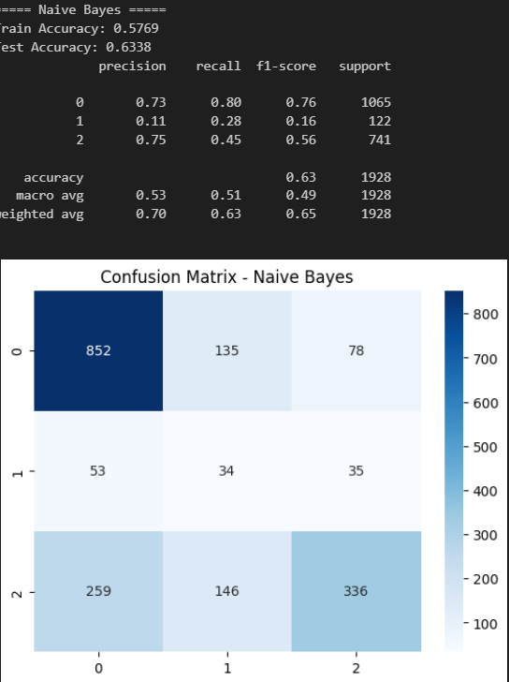
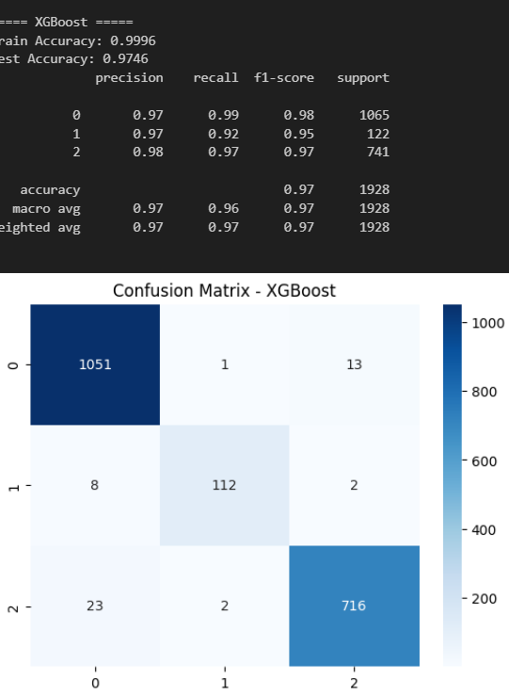
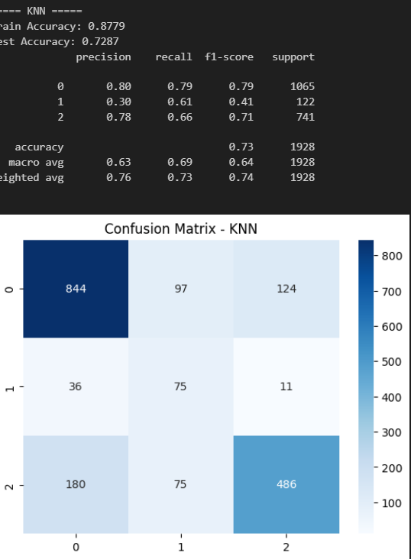
1. Best Model: XGBoost
Test Accuracy: 0.9746
Precision, Recall, F1: High across all classes, with a weighted F1 of 0.97.
Conclusion: Excellent performance overall.
2. Second Best: Knn
Test Accuracy: 0.7287
Precision, Recall, F1: Balanced, but struggles with Class 1 (low precision, moderate recall).
Conclusion: Decent but can be improved.
3. Third: Naïve bayes
Test Accuracy: 0.6338
Precision, Recall, F1: Very low performance for Class 1, with a macro F1 of 0.49.
Conclusion: Needs significant improvement.

Slide 27
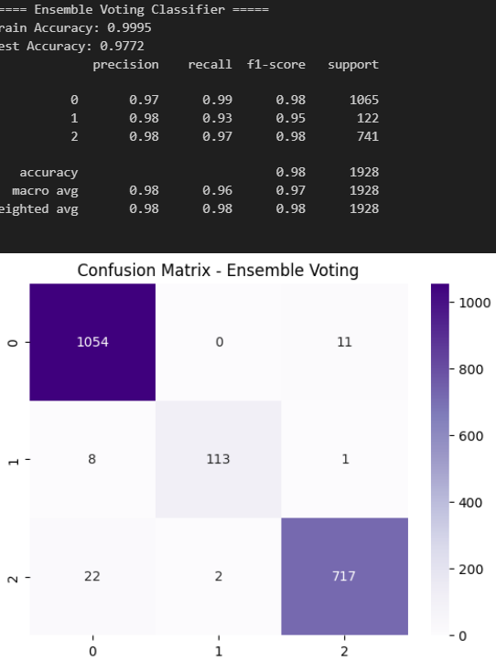
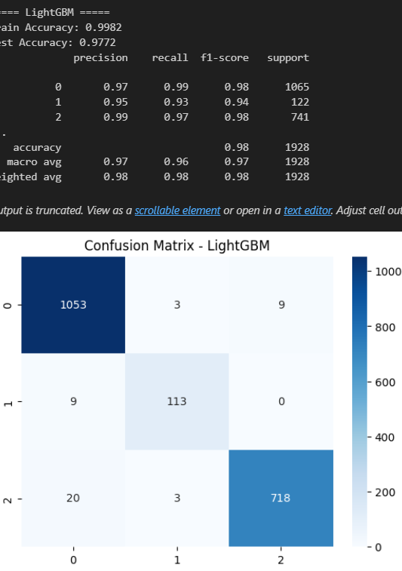
Modeling
Both have similar results

Slide 28
comparison
Model | Train Accuracy | Test Accuracy | Precision (Weighted) | Recall (Weighted) | F1-Score (Weighted) | Macro Avg F1 | Conclusion
LightGBM | 0.9982 | 0.9772 | 0.98 | 0.98 | 0.98 | 0.97 | Best model, excellent accuracy and balanced performance.
Ensemble Voting Classifier | 0.9995 | 0.9772 | 0.98 | 0.98 | 0.98 | 0.97 | Almost identical to LightGBM, very strong performance.
XGBoost | 0.9996 | 0.9746 | 0.97 | 0.97 | 0.97 | 0.96 | High performance, but slightly behind LightGBM and Ensemble.
KNN | 0.8779 | 0.7287 | 0.76 | 0.73 | 0.74 | 0.64 | Moderate performance, struggles with Class 1 precision and recall.
Naive Bayes | 0.5769 | 0.6338 | 0.70 | 0.63 | 0.65 | 0.49 | Weak performance, particularly for Class 1, needs major improvements.

Slide 29
Modeling
3. The third approach learning model with class-specific weight
It improves the performance by make the model pay more attention to underrepresented classes by assigning higher weights to misclassifications of theses classes

Slide 30
Model | Test Accuracy | Class 0 F1-Score | Class 1 F1-Score | Class 2 F1-Score | Overall Performance
LightGBM | 0.9756 | 0.98 | 0.95 | 0.97 | Best performance, balanced
XGBoost | 0.9746 | 0.98 | 0.95 | 0.97 | Best performance, balanced
Random Forest | 0.9689 | 0.97 | 0.93 | 0.97 | Strong, consistent
Decision Tree | 0.9398 | 0.94 | 0.85 | 0.94 | Good, solid performance
KNN | 0.7287 | 0.79 | 0.41 | 0.71 | Struggles with Class 1
Naive Bayes | 0.6338 | 0.76 | 0.16 | 0.56 | Weak on Class 1
Logistic Regression | 0.5462 | 0.48 | 0.01 | 0.62 | Low performance overall
SVM | 0.5441 | 0.45 | 0.32 | 0.62 | Poor performance overall

Slide 31
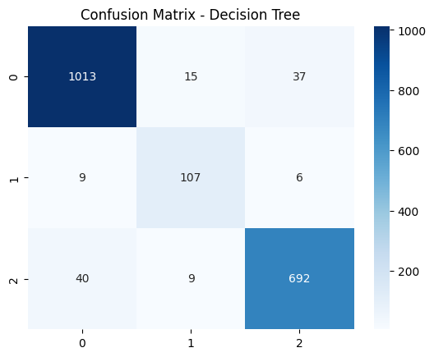
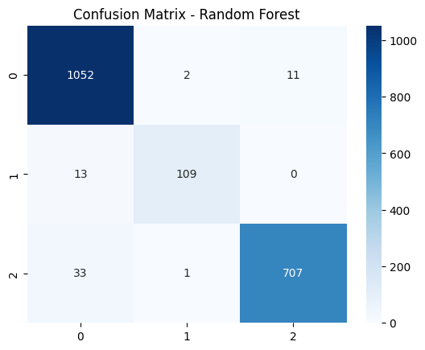
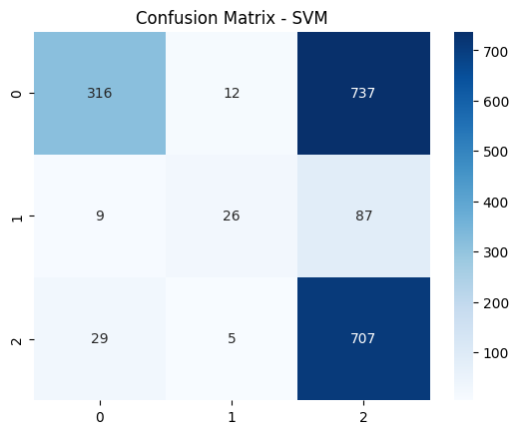
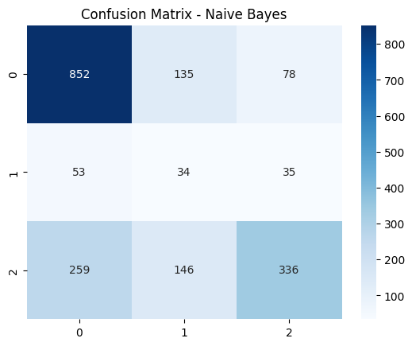

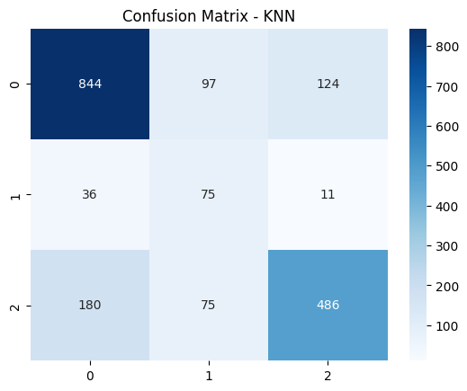

Slide 32
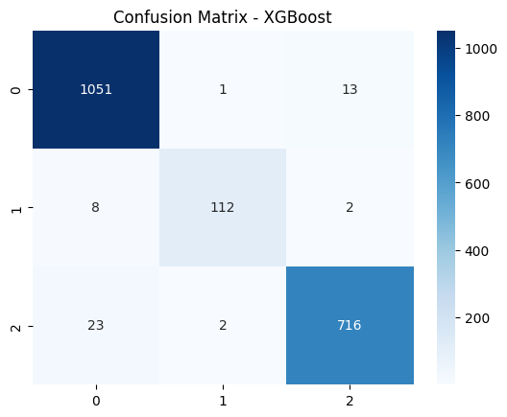
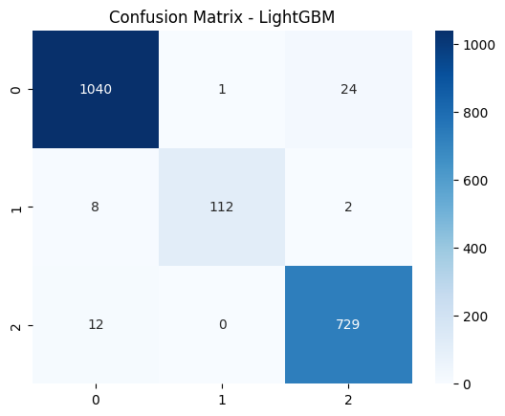

Slide 33
conclusion
After that we can say
If you notice abnormal about of hepatomegaly, spider vanes, enlarged limbs, yellow skin color or weight eyes, or heaviness in the right side of the body rush to the hospital
Stay healthy and a stay safe

Slide 34

conclusion
Best Performers: LightGBM and XGBoost
Mid-Range: Random Forest, Decision Tree
Lower Performers: KNN, Naive Bayes, Logistic Regression, SVM

